Slide 1
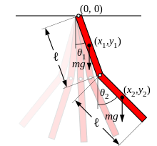
Chaos modelling of coupled ODEs
NamanYadav - 160100012
Riya - 160100097

Slide 2
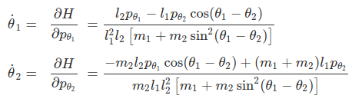
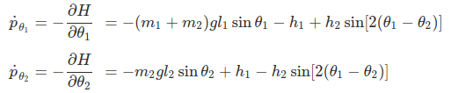


Problem Statement
We have simulated the double pendulum which is used to show an example of chaos dynamics, signifying the importance of initial conditions in non-linear systems. How the phase portrait of the system evolves over time have been studied for 5 seconds. The effect of change in the initial conditions on the trajectory of the midpoint of the 2nd link have been analyzed. We have used different solvers for solving the coupled equations and commented on the scope of various solvers in solving the chaotic systems. We have also analysed their sensitivity for abnormal length and mass ratio.
Equation of motion used are:

Slide 3
Methodology & Implementation
We have used python for programming and plotting the trajectory of the centre of mass of 2nd link as a function of time. The entire code is distributed in 3 files.
main.py - Different parameters required to run the code and how many sets of each parameter to simulate is set. In each-iteration it calls solve() from functions.py to simulate for each set of parameters and plot them using function of plot.py. In the end all plots are shown in the same figure.
functions.py - Contains functions to calculate derivatives of θ and p_{θ}. solve() iterates over time until final time is reached and call different slovers depending on value of “slvr” and return an array containing θ, t and other state-quantifiers (⍵ and p_{θ}). We have used the following solvers:
For all y = θ₁, θ₂, p_{θ1}, p_{θ2}
Explicit Euler: next_y = current_y + time-step*y_dot
Implicit Euler: an iterative procedure where next_y^{[k]} = current_y + time-step*y_dot, y_dot was calculated using (next_^{[k-1]}*(1-r) + current_y*r) until next_y^{[k]} and next_y^{[k-1]} are within some tolerance (given by rel_err_tol in the code) band
Runge-Kutta of order 4: next_y = current_y + (K₁+2K₂+2K₃+K₄)/6 where K_{i} = time-step*y_dot, y_dot was calculated using current_y+K_{i-1}*(0, 1 or ½ depending on i)
plot.py - plt_lnk2_cm function computes the trajectory of centre of mass of 2nd link and plots it.
Notes:
The following algorithm has been coded in Python.
Initialisation of the array containing various values of 𝜃₁, 𝜃₂, p_{𝜃1} and p_{𝜃2} and the time-step.
An outer for-loop which will run to execute all sets of initial conditions.
Within each loop, 𝜃₁, 𝜃₂, p_{𝜃1} and p_{𝜃2} are initialised and time (t) is set to zero; and an array is declared to store state-variables.
An inner while-loop which will run until the t becomes equal to final time-value.
The while-loop ends with updating state-variables by calling the desired solver.
Position of centre of both the rods is calculated for the theta-values at each time-instance using a for-loop.
Explicit solver: The state-variables are updated by calculating their derivatives by calling appropriate functions using the current state-variables.
Implicit solver:
𝜃₁, 𝜃₂, p_{𝜃1} and p_{𝜃2} are initialised for the next time-instance by summing the current values with the product of time-step and their derivatives calculated using current values.
Another while-loop is used to update the values of 𝜃₁, 𝜃₂, p_{𝜃1} and p_{𝜃2} until the relative error between the obtained variables in the consequent iterations is less than 1e-6. The error is calculated using the declared function “hgh_rel_err”.
Inside the while-loop for calculation of derivatives, 𝜃₁, 𝜃₂, p_{𝜃1} and p_{𝜃2} are generated by calculating weighted-average of these values in the previous iteration and the initial values (obtained in step1)

Slide 4
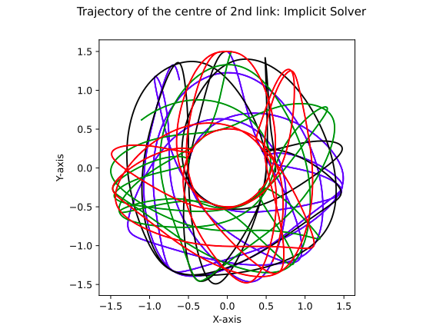
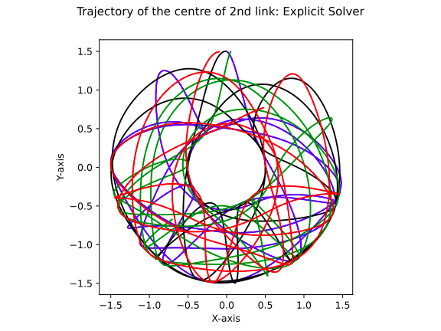
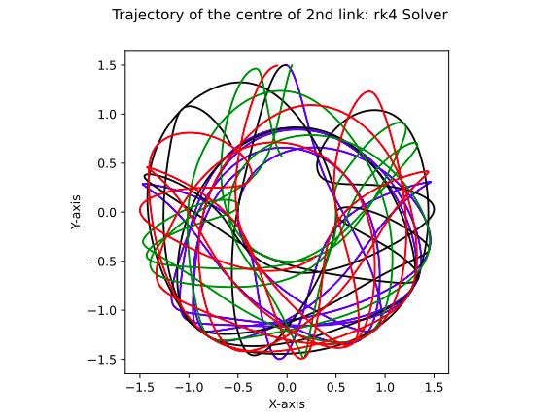
Butterfly effect
Butterfly effect in the double pendulum system is seen as large difference in trajectory on making small changes to initial condition. The effect observed upon using different solvers is shown in the following plots where different colours imply different initial conditions. (Time step = 0.001 second)
Initial Conditions used:
 | 1 | 2 | 3 | 4
𝜃₁ | 180 | 180.573 | 180 | 185.73
𝜃₂ | 180.573 | 180 | 174.27 | 180

Slide 5
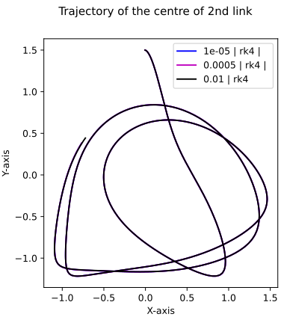
Comparing different solvers
For comparing different solvers time step was varied and it
was observed that Runge-Kutta (4th order) solver gives accurate
results even at 0.01 s time step. Due to higher accuracy of RK4,
trajectories obtained using implicit and explicit solvers were
plotted against it in for comparison.
Implicit and explicit solvers required much less time step
compared to RK4 as shown in next slide. Although both of these
solvers matched RK4 at around same time step, we can seen
that explicit solver was far away from actual trajectory compared
to implicit for larger time step (magenta curve in the figures).
These simulations were done using:
m1 = m2 = 1
l1 = l2 = 1
ti = 0 s
tf = 5 s

Slide 6
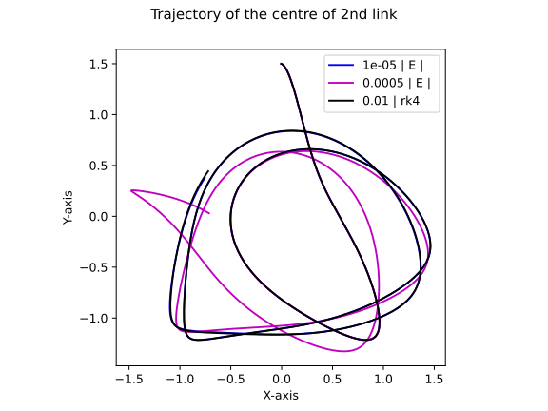
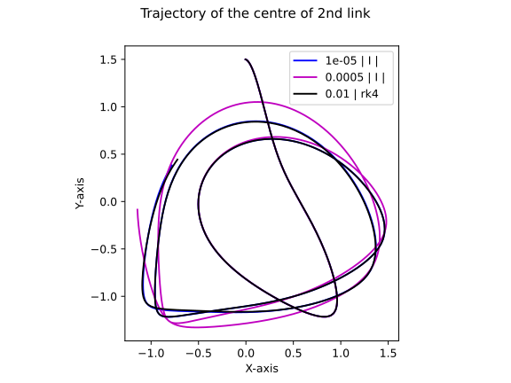
Comparing different solvers

Slide 7
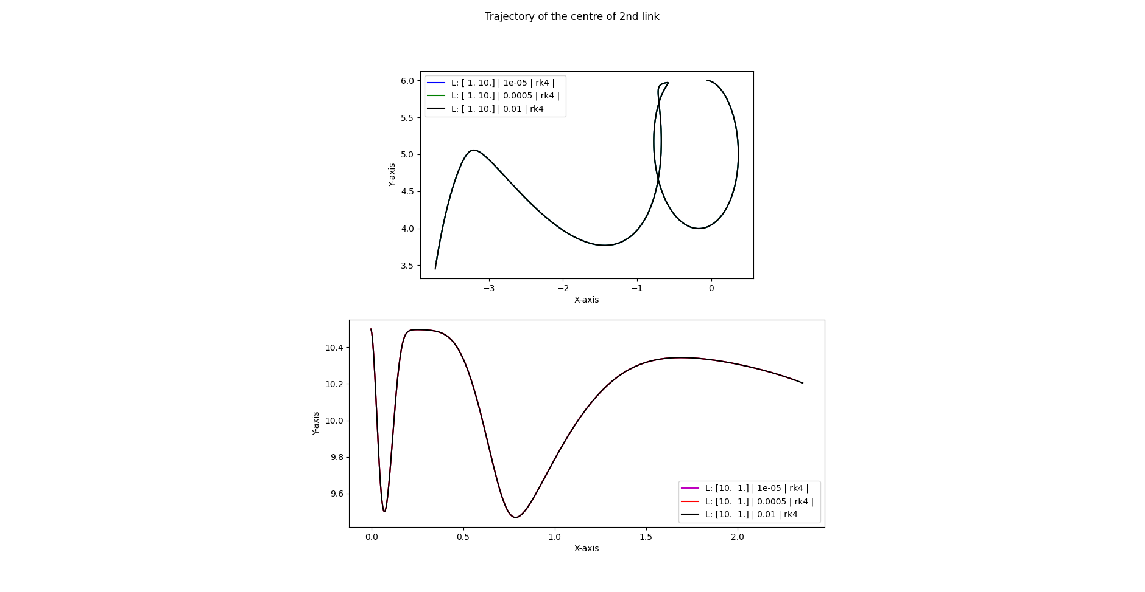
Effect of abnormal length ratio
Length ratio first and second link was changed
and the behaviour of different solvers was
analyzed for very high and very low length ratios.
Plots representing explicit and implicit solvers
are given on the next slide.
Following two ratios were analyzed:
l1/l2 = 0.1
l1/l2 = 10
Implicit solver starts deviating before explicit
solver for abnormal length ratios.

Slide 8
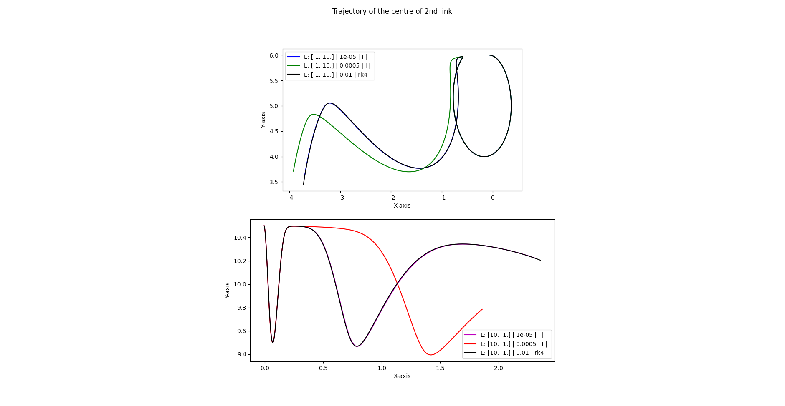
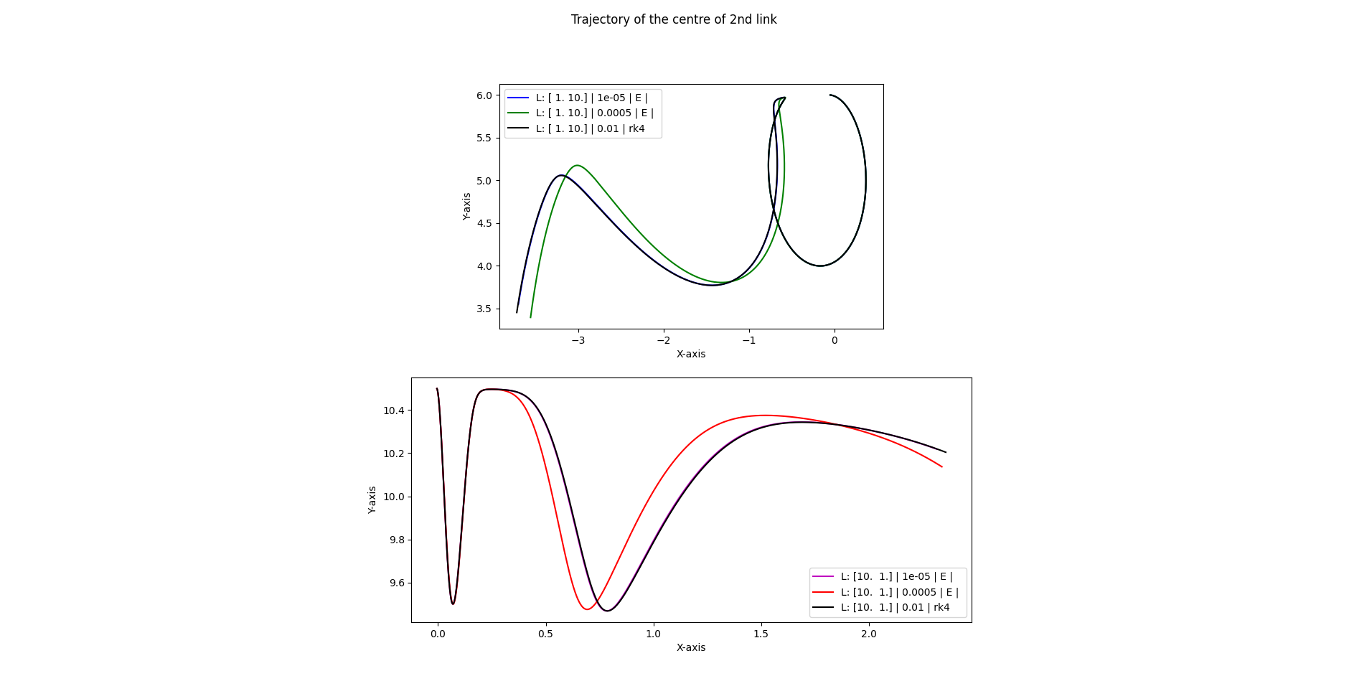

Slide 9
Effect of abnormal mass ratio
Mass ratio first and second link was changed and the behaviour of different solvers was analyzed for very high and very low mass ratios.
Plots representing different solvers are given on next slide.
Following two ratios were analyzed:
m1/m2 = 0.1
m1/m2 = 10
Solvers require lower time steps to produce accurate results for very low mass ratio compared to very high mass ratio.

Slide 10
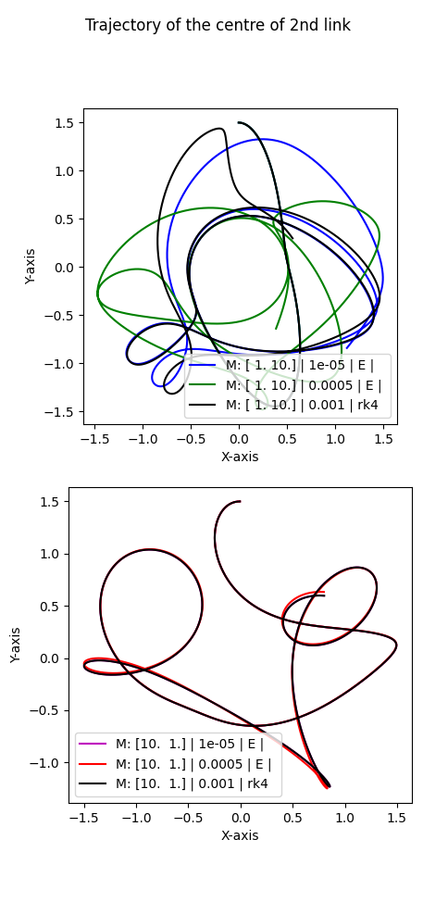
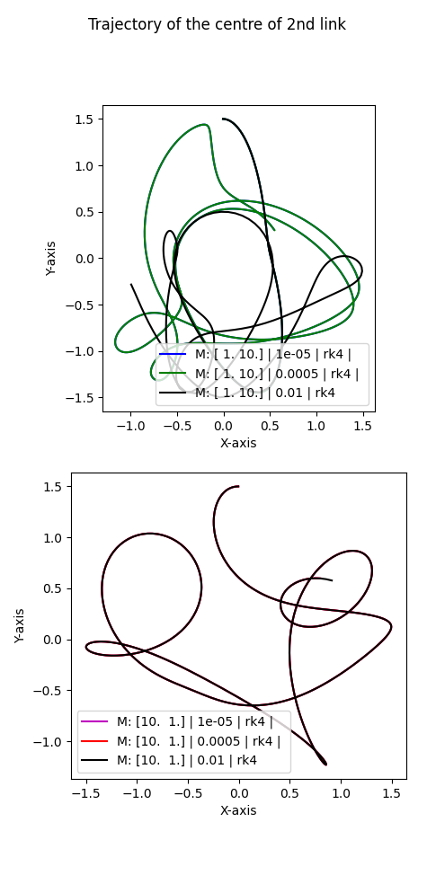
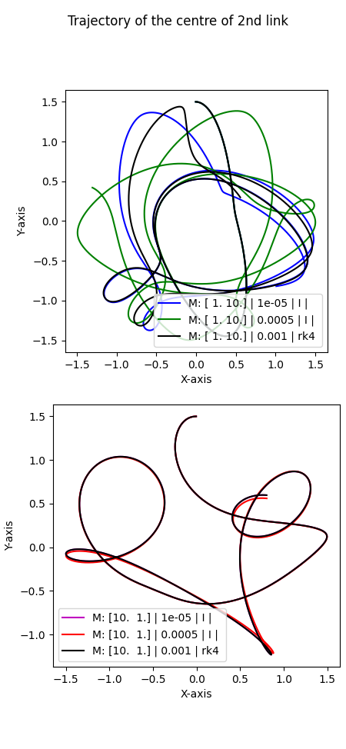

Slide 11
Instructions to run the code
Running main.py would give results using parameters set by us. There are two more files that main.py imports from (plot.py and functions.py). To get different results, one can modify main.py as following:
Change values in theta1_i, theta2_i, p1_i, p2_i to change the initial condition of the pendulum. i^{th} element of each array is combined to form a set of initial conditions.
Change values in mss and lss to change length and mass of the system. i^{th} row of each array is combined to form a system.
Change values in stps to change time-step used in solver and ti and tf to change duration of simulation.
Set the value in I, J, K, L, M depending upon how many sets of respective parameters you want to simulate. For simulating all sets of a particular parameter, set it to len(name_of_respective_variable) To get a sensible plot, don’t set non-unity more than two of I, J, K, L, M.
I - initial conditions (ys_inits)
J - solvers (slvrs)
K - time-steps (stps)
L - length (lss)
M - mass (mss)
For plotting there are some other parameters also that can be tuned, main.py file is appropriately documented to explain the details.

